Slide 1
Targeted Synthetic BLE Packet Data Generation Approach (Midterm)
16.12.2024
Keisuke Yokota

Slide 2
Executive Summary
Introduction
Background
Index
Design
Implementation
What I will do

Slide 3
Executive Summary
Introduction
Background
Index
Design
Implementation
What I will do

Slide 4



Executive Summary
The Goal
Investigate the usefulness of the Markov model in synthesizing data in BLE packets
Clarify to be a Markov model appropriate for creating BLE data
Create synthesis data of BLE using a Markov model
Evaluate the synthetic data
What I did
Generate synthetic data with the Markov model
Understood the basics of BLE packet structure and synthetic data
Researched related work
Determined which BLE packet data to synthesize
Generated synthetic data with Markov model
What I will do
Evaluate the synthetic data
Compare the structure of data with synthetic data and original data
Compare confidence levels between models with and without synthetic data

Slide 5
Executive Summary
Introduction
Background
Index
Design
Implementation
What I will do

Slide 6


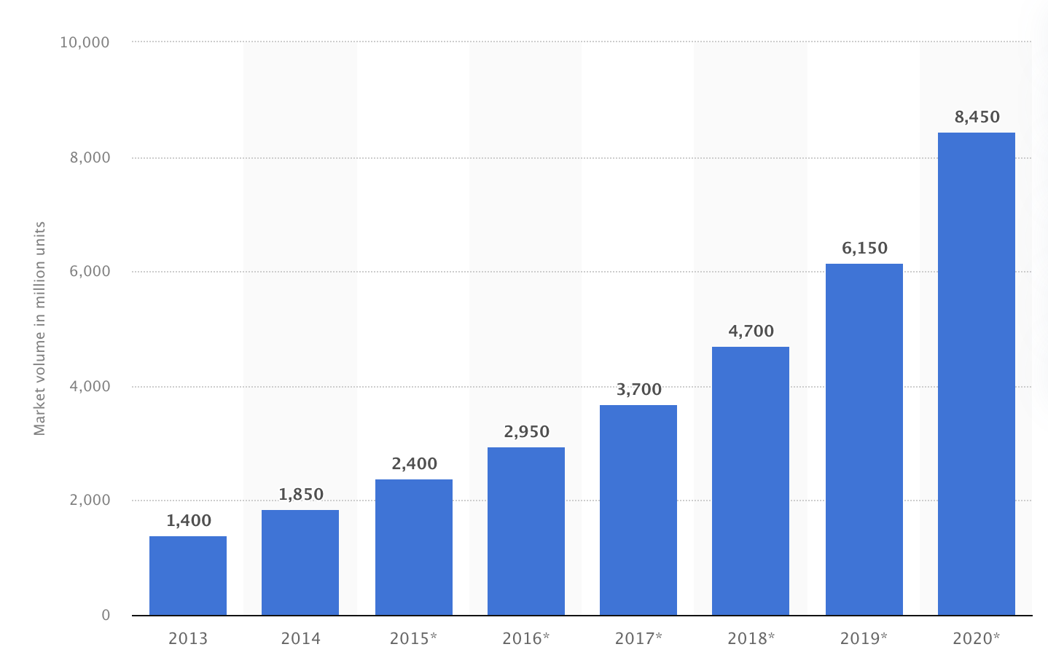

The current state of BLE
BLE devices market volume (in million units)
BLE is abused.
Examples of BLE Abuse
AirTag is slipped into a car to illegally obtain location data (Bern, 2022)
A woman used an AirTag to trach her boyfriend and later killed him (US, 2022)
A woman was stalked by her ex-boyfriend using an AirTag, and she was ultimately shot with a gun. (US 2022)
BLE showed up in the market in 2011 with the iPhone 4s
BLE is used in smartphones, smartwatches, speakers, and personal tracking devices like AirTag.
It is important to develop a model
to detect and classify BLE devices
https://www.statista.com/statistics/750569/worldwide-bluetooth-low-energy-device-market-volume/, https://www.20min.ch/story/ich-hatte-panik-bernerin-19-findet-fremden-airtag-unter-ihrem-beifahrersitz-460234987350, https://www.nzz.ch/panorama/airtag-stalking-hat-apple-die-gefahr-unterschaetzt-ld.1688765?reduced=true
Notes:
BLEデバイスが普及する一方でストーカーに悪用されるなどの問題があり、BLEデバイスを検知し、分類するモデルの必要性が高まる。
BLE devices are becoming popular. However, their misuse by stalkers highlights the growing need for models to detect and classify such devices.
↓AirTagを使用した事件
https://ascii.jp/elem/000/004/219/4219026/

Slide 7




Why generate synthetic data?
Importance of large dataset
Cost and risk
Large Dataset
It may not be possible to extract enough meaningful features with a small dataset.
Time and monetary cost
Collecting large amounts of data is time-consuming and financially costly.
Diverse Dataset
Real-world data contains noise. Diverse data is needed to deal with these noises.
Privacy issues
Data from the BLE device would reveal the user's location.
Synthetic data resolves these problems
https://ieeexplore.ieee.org/abstract/document/9706334, https://doi.org/10.1186/s40537-023-00727-2
Notes:
A large amount of diverse data is needed to create a classification model. However, data collection is costly. Therefore, synthetic data is created.

Slide 8





Research questions
Clarify to be a Markov model appropriate for creating BLE data
Goals
Create synthesis data of BLE using
a Markov model
Evaluate the synthetic data
Notes:
The objective of this research is to generate high-quality synthetic data of BLE packets using the Markov model.

Slide 9
Executive Summary
Introduction
Background
Index
Design
Implementation
What I will do

Slide 10





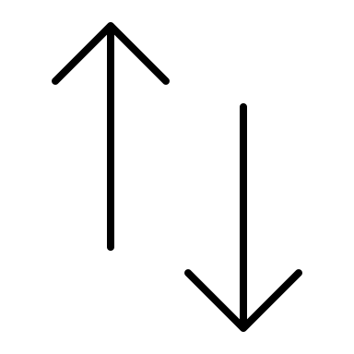
How Does BLE Communicate?
Searching central
One-to-one connection
Advertising
Central
(e.g., iPhone)
one-to-one connection
Periphera (e.g., AirTag)
https://www.bluetooth.org/DocMan/handlers/DownloadDoc.ashx?doc_id=556599,
Notes:
BLEの説明。ペリフェラルとセントラルがあり、相手を探すときのアドバタイジングを分析する。
Advertising packets are analyzed to classify BLE devices.

Slide 11
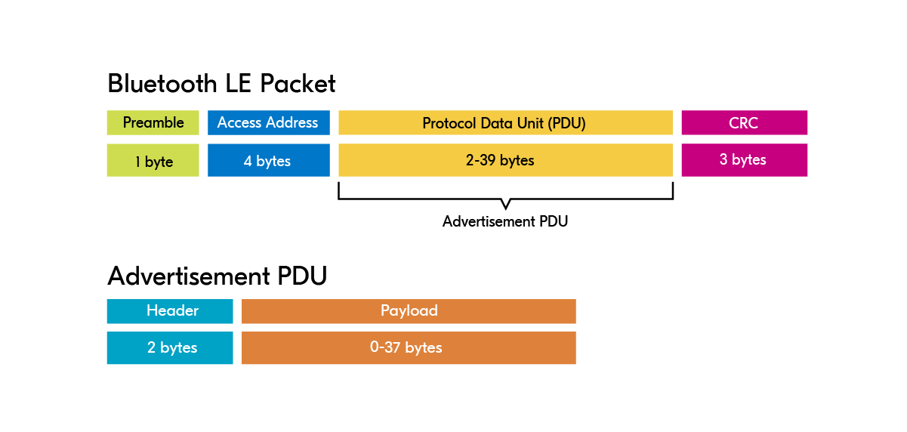
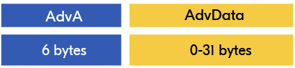
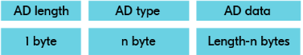
BLE packet structure
High level
BLE Packet
Advertisement PDU
Payload
Adv Data
Low level
https://academy.nordicsemi.com/courses/bluetooth-low-energy-fundamentals/lessons/lesson-2-bluetooth-le-advertising/topic/advertisement-packet/
Notes:
アドバタイジングではPDUに注目する。パケットは一定の構造に従ってる。
BLE packets follow a specific structure. When analyzing advertising packets, focus is placed on the PDU (Protocol Data Unit).
BLEは一定の構造に従ってる。
ADVとかが大事そうだ

Slide 12




Synthetic Data
Overview of synthetic data
How to generate synthetic data
What is synthetic data?
Synthetic data is artificial data created to mimic real-world data characteristics and structures.
Statistics
What are the benefits of synthetic data?
1
Unlimited data
Machine learning
2
No privacy issue
3
Reduce bias
4
Reduce time costs
Deep learning
5
Reduce monetary costs
https://www.edps.europa.eu/press-publications/publications/techsonar/synthetic-data_en#:~:text=Synthetic%20data%20is%20artificial%20data,undergoing%20the%20same%20statistical%20analysis, https://doi.org/10.1086/722094, https://arxiv.org/abs/2210.07332, https://doi.org/10.1109/ACCESS.2023.3325235, https://aws.amazon.com/what-is/synthetic-data/?nc1=h_ls, https://www.sciencedirect.com/science/article/pii/S0167947311002076, https://ieeexplore.ieee.org/document/9570308
Notes:
合成データとは何か、その目的
Synthetic data refers to artificially generated data that mimics the characteristics and structure of real-world data.

Slide 13








Markov Model
How does Markov model work
Pros and Cons
0.5
Suitable for time-series data and structured data
0.4
0.5
0.1
0.5
0.1
Limited data diversification
0.3
0.4
Cloudy
Rainy
Sunny
0.2
https://doi.org/10.1177/0272989X9301300409
13

Slide 14






Hidden Markov Model
How does Hidden markov model work
Pros and Cons
0.5
Observable data
0.7
0.0
0.3
Capable of handling complex data structures
Hidden state
Shop
Walk
Clean
0.4
0.5
0.1
0.5
0.1
Difficult to interpret
0.3
0.4
Cloudy
Rainy
Sunny
0.4
0.3
0.3
0.1
0.5
0.4
Shop
Walk
Clean
0.2
Shop
Walk
Clean
https://www.sciencedirect.com/science/article/pii/S0167865504002922
14

Slide 15





GAN
How does GAN work
Pros and Cons
Noise
Generator
Fake Data
Ensuring data diversity
Real
Discriminator
Not well-suited for generating structured data
Real Data
Fake
arXiv:1406.2661
15

Slide 16



Stefan‘s work (I am expanding his research)
XXXX
XXXX
What he did
Limitation
Created a database of BLE
30 million packets of data were collected from a wide variety of devices
Controlled environment
Accuracy
Real-world environment
99%
80%
Built a model to classify BLE
A machine-learning model to classify BLE trackers was created.
I used this dataset to generate synthetic data
I will use this model to evaluate the generated data
Increase data diversity to improve accuracy by generating synthetic data
Stefan 2024
Notes:
Stefanの研究の説明。（何をしたのか、何が限界なのか）→だから合成データを作る
Stefan created a BLE dataset and classification model. While the accuracy of test data is high, the accuracy of real-world data is not as satisfactory.

Slide 17

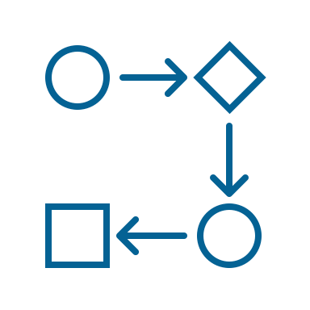
Previous studies were reviewed from two perspectives.
Relating to BLE
Creating synthetic data using Markov model
Generated synthetic data relating to BLE
RSSI data used for BLE beacon location tracking
IP packets and TCP/UDP flow
Used the Markov model
High-resolution solar radiation data
Wind speed data
Conducted simulation relating to BLE
Multiple BLE advertising packets colliding
BLE wireless sensor networks
Used the Hidden Markov model
Financial time series data
Population data
No studies have generated synthetic data for BLE
The Markov model is used to generate
synthetic time-series data
https://ieeexplore.ieee.org/document/9366479, https://theses.hal.science/LAAS-RISC/hal-04797964v1, http://dx.doi.org/10.1109/ACCESS.2018.2866323, http://dx.doi.org/10.3390/jsan9030038, https://www.sciencedirect.com/science/article/pii/S0038092X14001042, https://ieeexplore.ieee.org/document/9687770, http://dx.doi.org/10.1080/14697688.2015.1004801, https://www.sciencedirect.com/science/article/pii/S0191261515300904
Notes:
先行研究ではBLEパケットの合成に取り組んだ研究はなかった。→この研究には意味がある。

Slide 18
Overview of related works
Research
Synthesize BLE
packet data
Related
Markov model
Time series data
Can this be used to create synthetic BLE packets?
Synthesizing data
Simulation
Not Hidden
Hidden
Method
Data
1
No
Yes
No
No
No
Yes
No
Partially
2
No
Yes
No
No
No
Yes
No
Partially
3
No
No
Yes
No
No
Yes
No
Partially
4
No
No
Yes
No
No
Yes
No
Partially
5
No
Yes
No
No
No
Yes
No
Partially
6
No
Yes
No
Yes
No
Yes
Yes
No
7
No
Yes
No
Yes
No
Yes
Yes
No
8
No
Yes
No
Yes
No
Yes
Yes
No
9
No
Yes
No
No
Yes
Yes
No
No
10
No
Yes
No
No
Yes
No
No
No
11
No
Yes
No
No
Yes
No
No
No
This Research
Yes
Yes
No
Yes
No
Yes
Yes
Yes
Notes:
There are no existing studies that have focused on synthesizing BLE packet data. Markov Models are commonly used for synthesizing time-series data.

Slide 19
Executive Summary
Introduction
Background
Index
Design
Implementation
What I will do

Slide 20
Method Selection
Markov Model
Hidden Markov Model
GAN
Suitable for time-series data
Suitable for structured data
Suitable for complex structured data
Suitable when interested in the underlying states of the data
Ensuring data diversity
Not suitable for structured data
BLE packet data is time-series and structured data.
The main goal is to generate synthetic data, not investigate hidden states.
BLE is structured data.
Notes:
Given that BLE packet data has a defined structure and is time-series in nature, the Markov Model is chosen.
BLEパケットデータは構造が決まっていることと、時系列データであることからマルコフモデルを選択する。

Slide 21



Data Selection
Preprocessed SmartTag (nearby)
SmartTag (nearby)
Preprocessed
Small data volume
Can be compared with Stefan's results
Low accuracy
The existing model
can be used

Slide 22

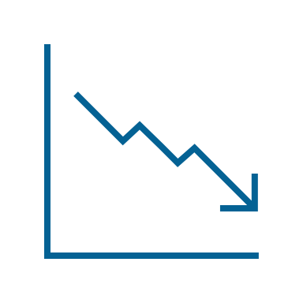
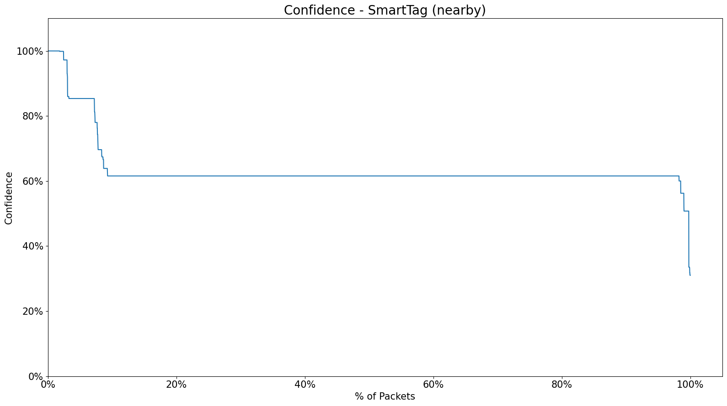
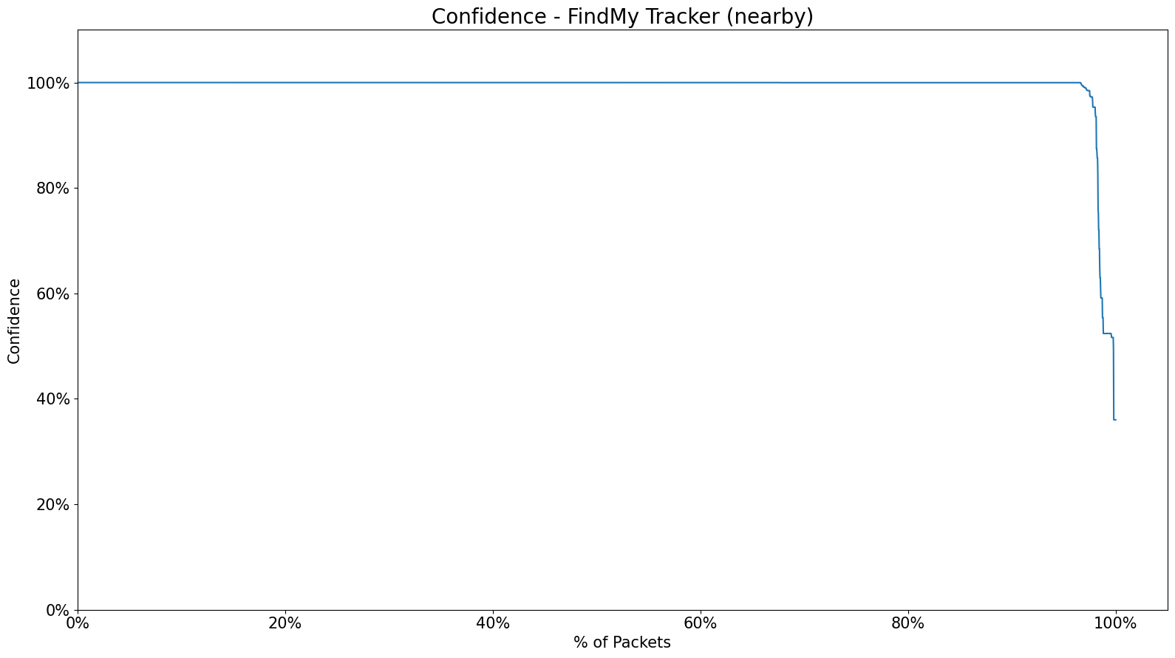
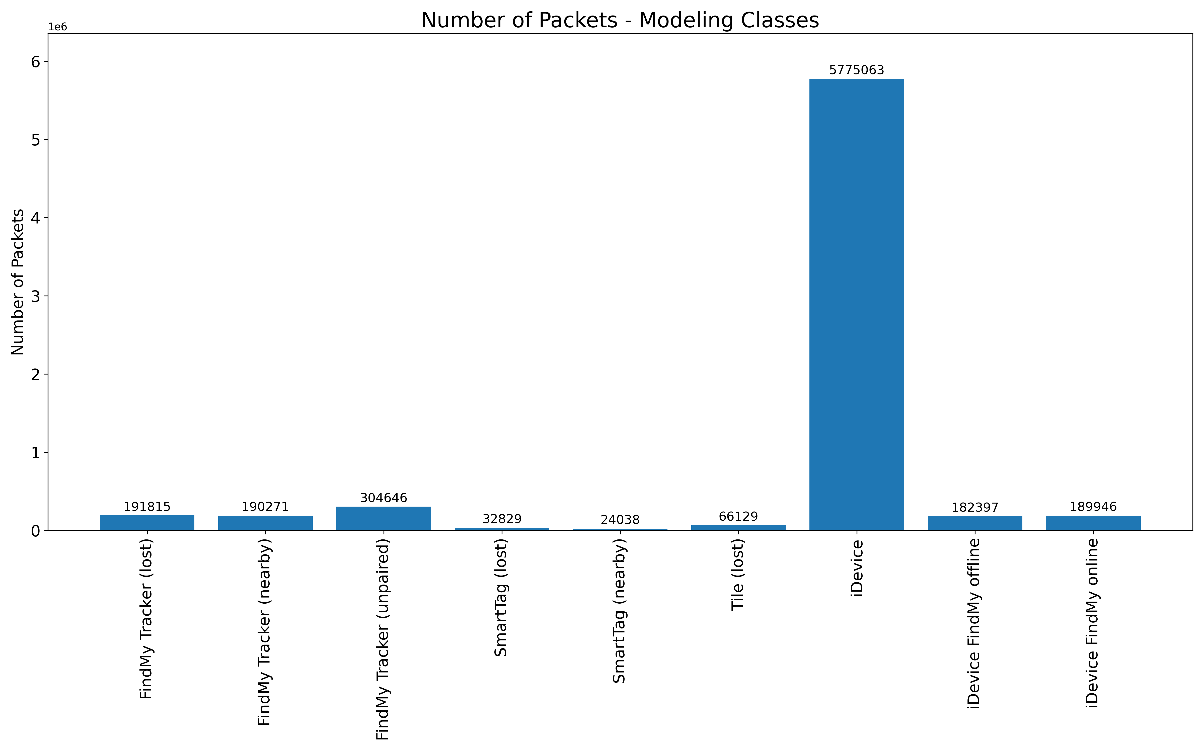
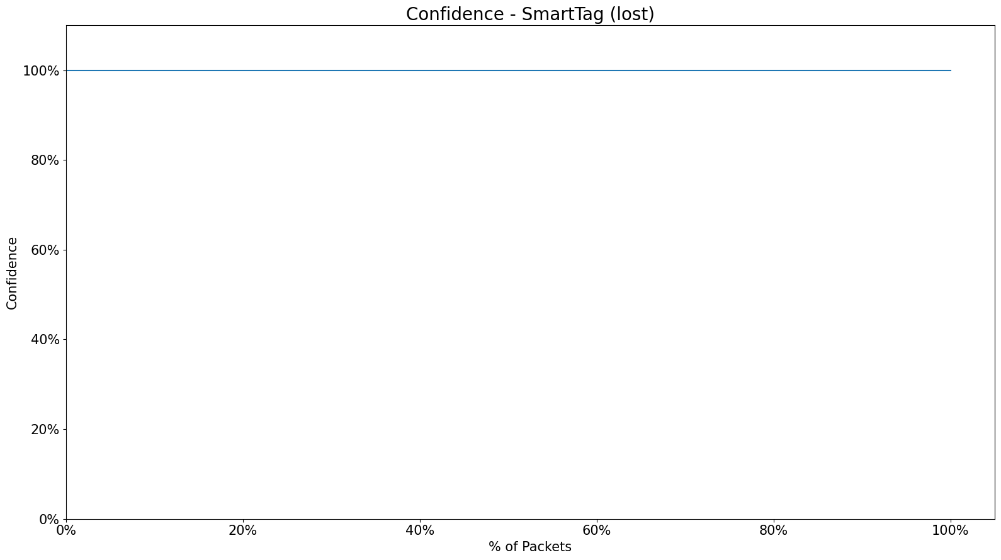
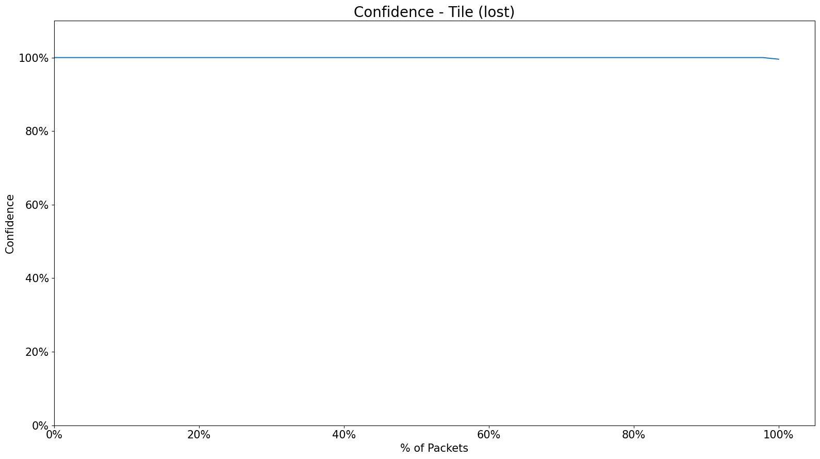
Data Selection
Number of packets
Accuracy
22

Slide 23
Data Selection (Number of packets)
23

Slide 24
Data Selection (Accuracy)
24

Slide 25
Executive Summary
Introduction
Background
Index
Design
Implementation
What I will do

Slide 26



Implementation
Run Markov model
Run a Markov model for each group of grouped columns
Group columns
Treat highly related columns as the same state
Investigate columns
Investigate the number of unique values for each column

Slide 27
Executive Summary
Introduction
Background
Index
Design
Implementation
What I will do

Slide 28

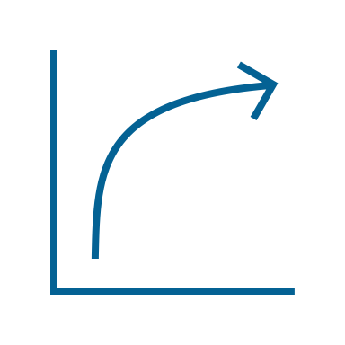
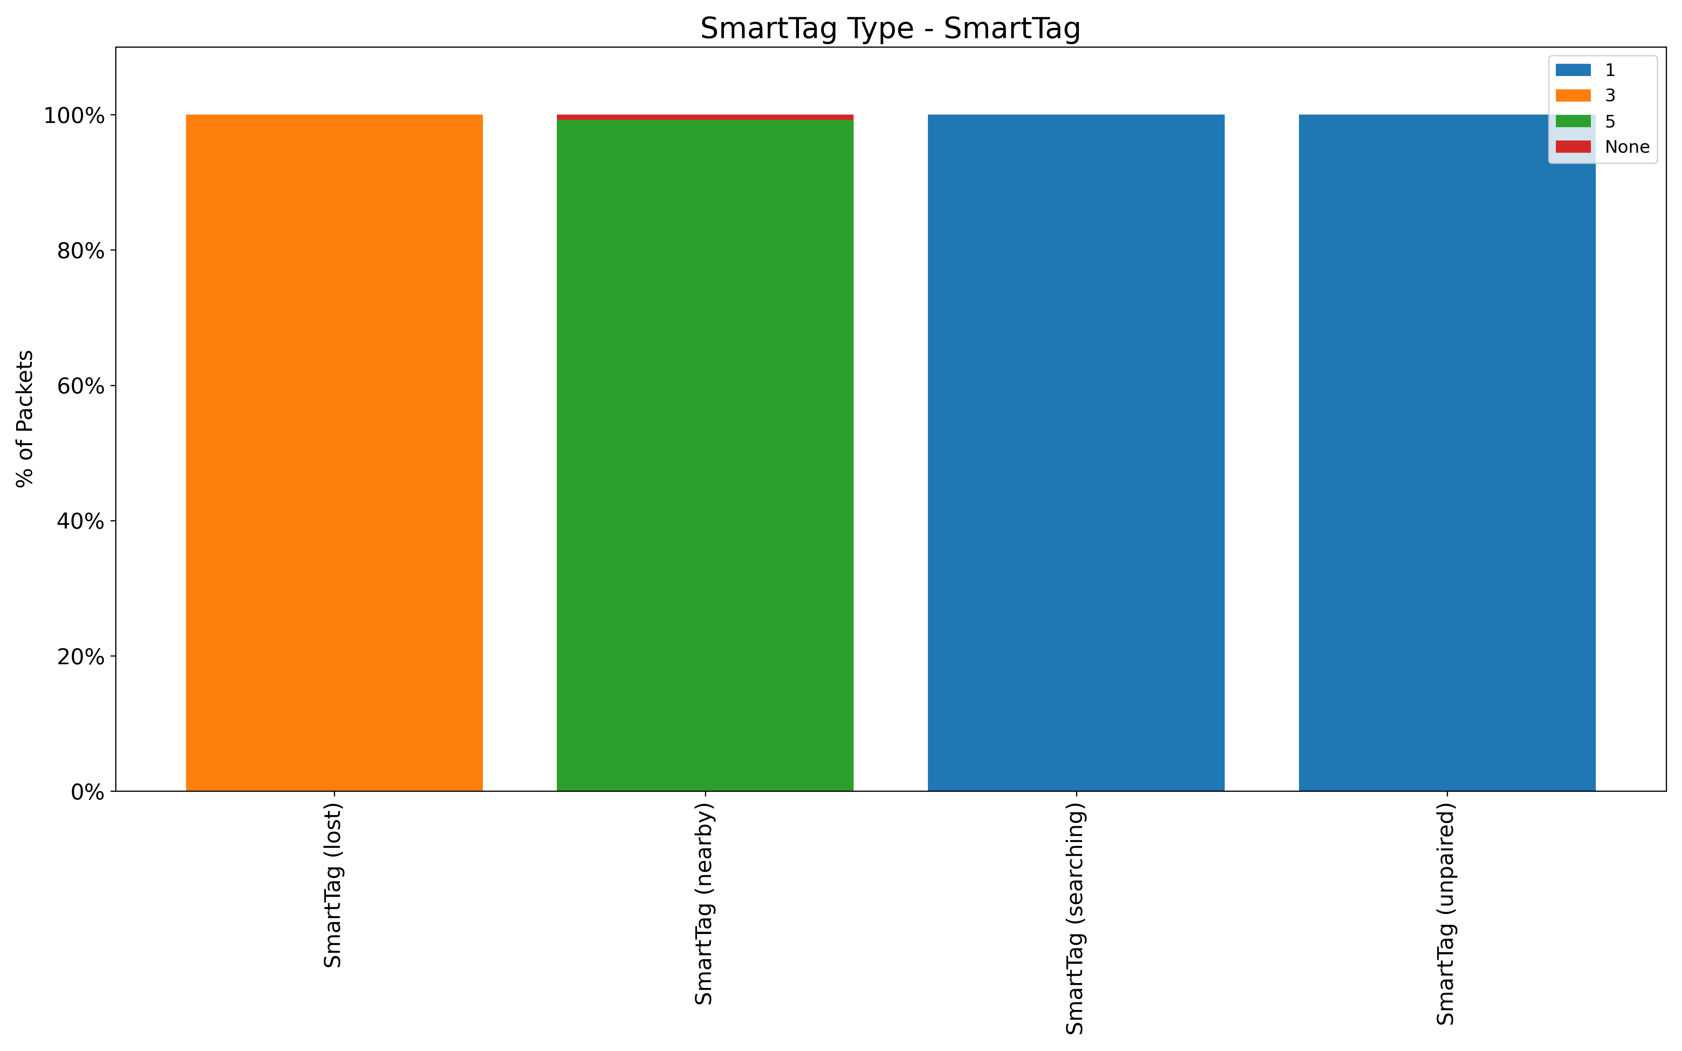
The next task is to evaluate the synthetic data. The evaluation will be conducted from two perspectives.
Data Structure
Confidence Lebel
Compare the structure of data with synthetic data and original data.
Compare confidence levels between models with and without synthetic data.
Stefan’s Github

